Slide 1
Cortex M3 Instruction set Example

Slide 2
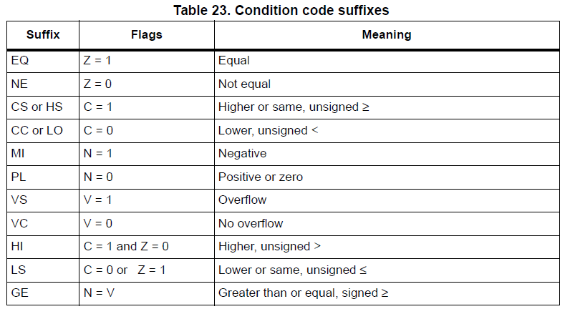

Slide 3


Slide 4


Slide 5


Slide 6


Slide 7


Slide 9
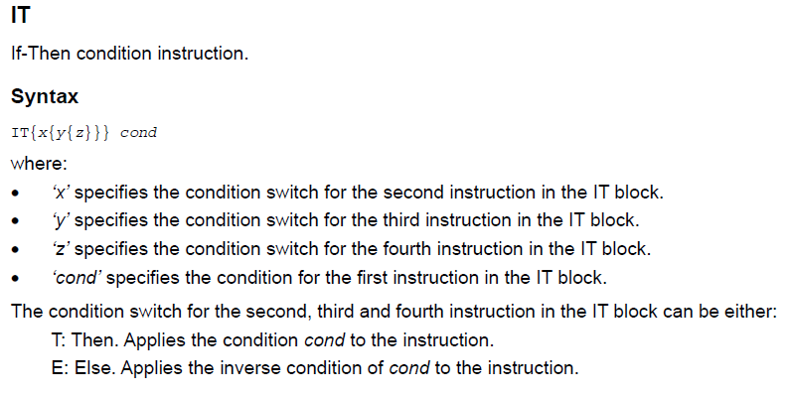

Slide 10
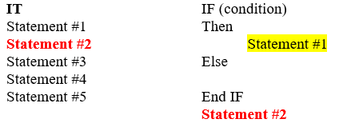

Slide 11
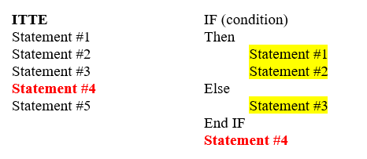

Slide 12
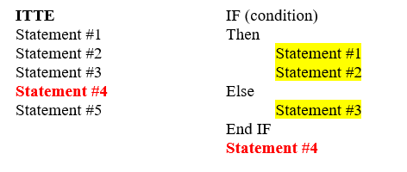

Slide 13
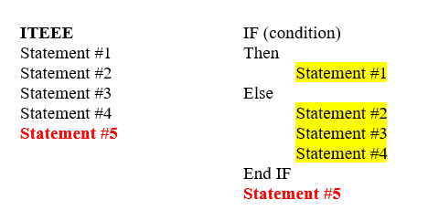

Slide 14
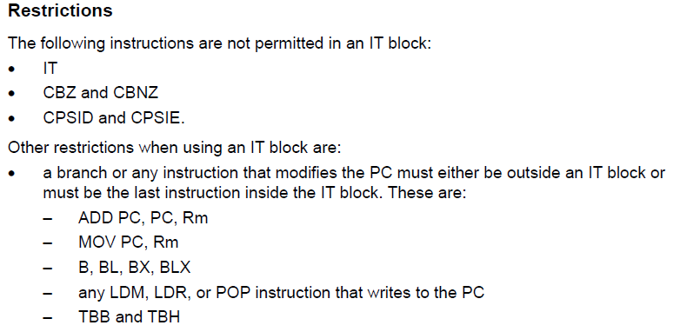

Slide 15


Slide 16



Slide 17


Slide 18
Byte Alignment:
Byte-aligned addresses are addresses where the memory location starts at any byte boundary.
For example, 0x20000000, 0x20000001, 0x20000002, etc., are

Slide 19
Half-Word Alignment:
Half-word alignment requires that the memory address starts at a multiple of 2 bytes.
Addresses like 0x20000000, 0x20000002, 0x20000004, etc., are half-word aligned.

Slide 20
Word Alignment:
Word alignment requires that the memory address starts at a multiple of 4 bytes.
Addresses like 0x20000000, 0x20000004, 0x20000008

Slide 21


Slide 22


Slide 23
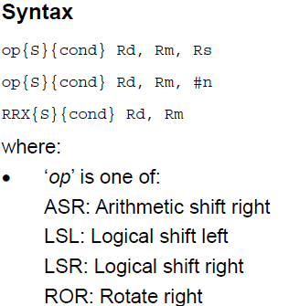

Slide 24


Slide 25


Slide 26


Slide 27


Slide 28


Slide 29


Slide 30


Slide 31

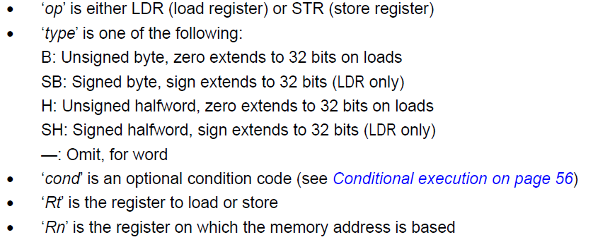

Slide 32
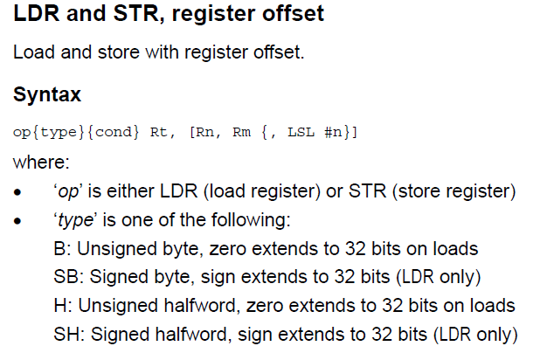


Slide 33


Slide 34
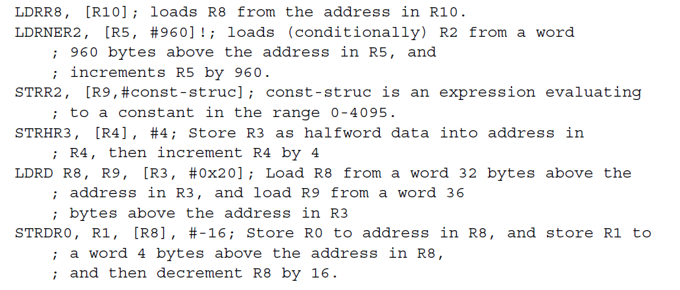

Slide 35


Slide 36



Slide 37


Slide 38
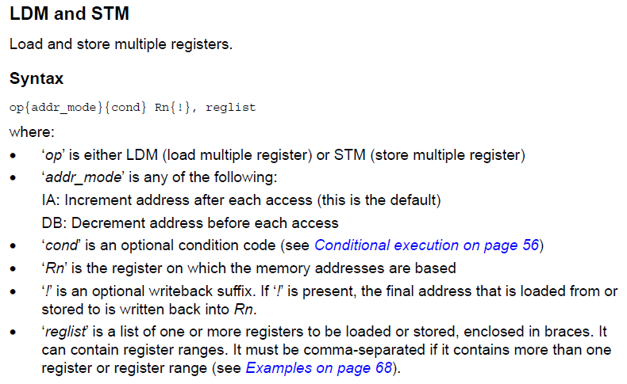

Slide 39


Slide 40


Slide 41
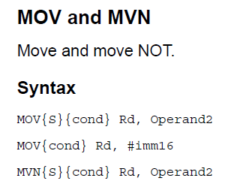

Slide 42
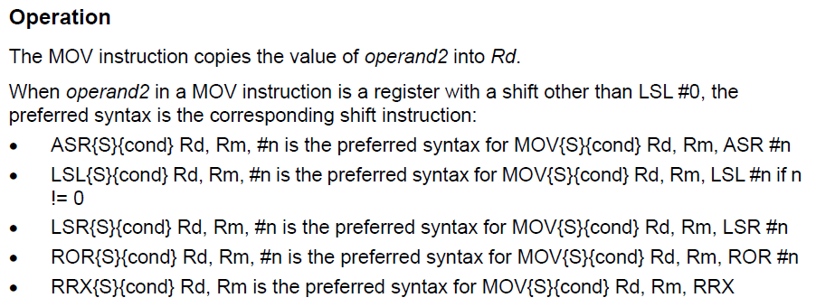

Slide 43


Slide 44
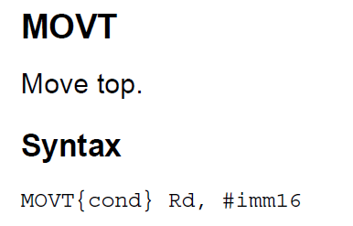

Slide 45


Slide 46


Slide 47
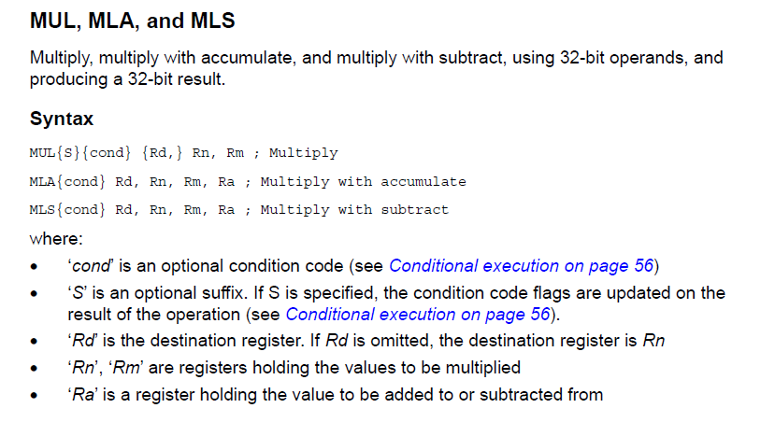

Slide 48


Slide 49
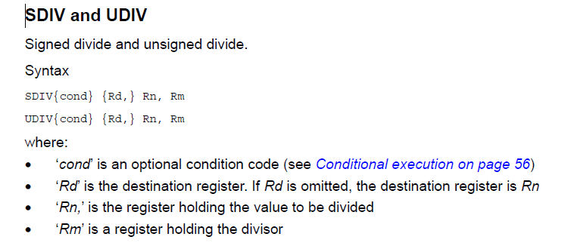


Slide 50
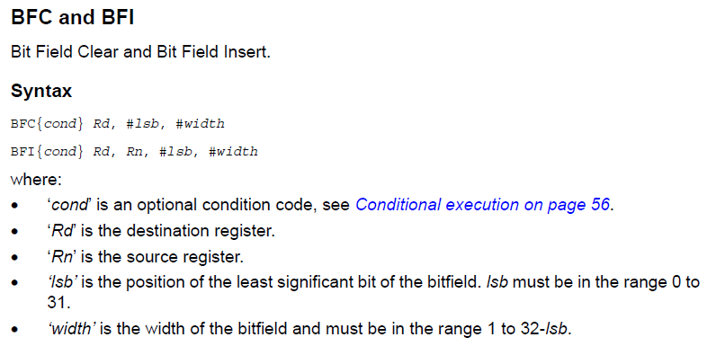

Slide 51


Slide 52
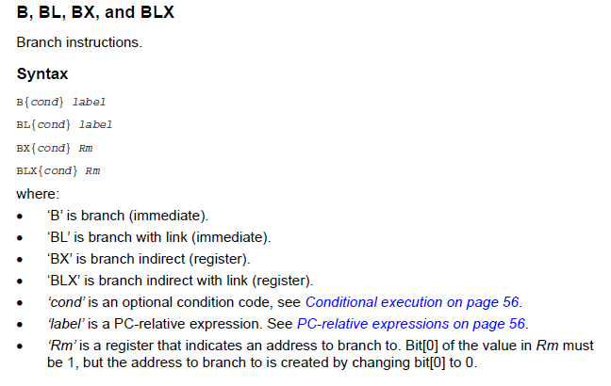

Slide 53
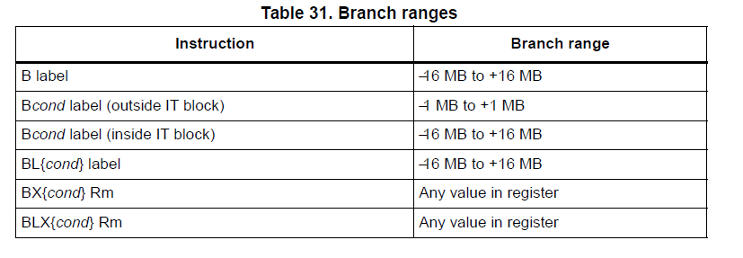

Slide 54
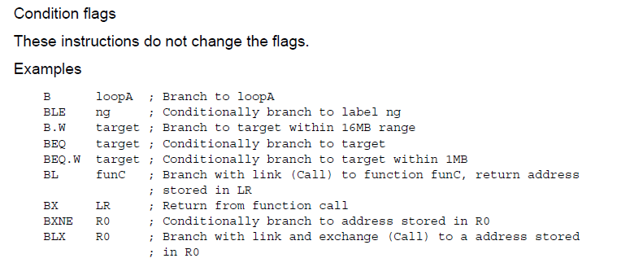

Slide 55
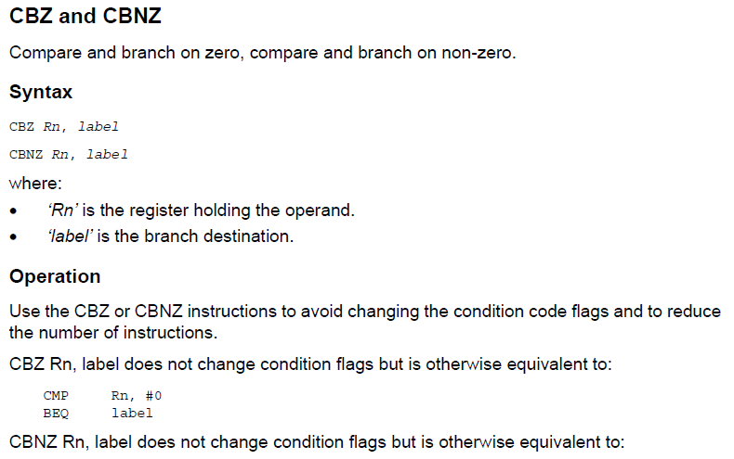

Slide 56
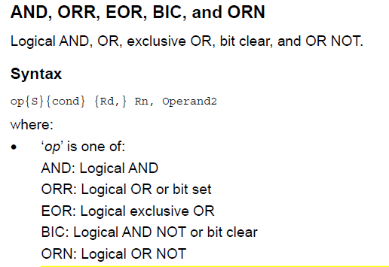

Slide 57
